Slide 1





Compiler-directed Migrating API Callsite of Client Code
Hao Zhong
Na Meng
Shanghai Jiao Tong University
Virginia Polytechnic Institute
ICSE 2024 46th International Conference on Software Engineering
Notes:
Good afternoon. I am Hao Zhong, from Shanghai Jiao Tong University. Today, I will introduce our work on code migration. This is a joint work with Na Meng from Virginia Tech.

Slide 2
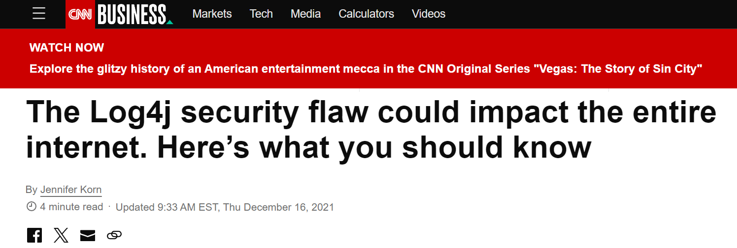

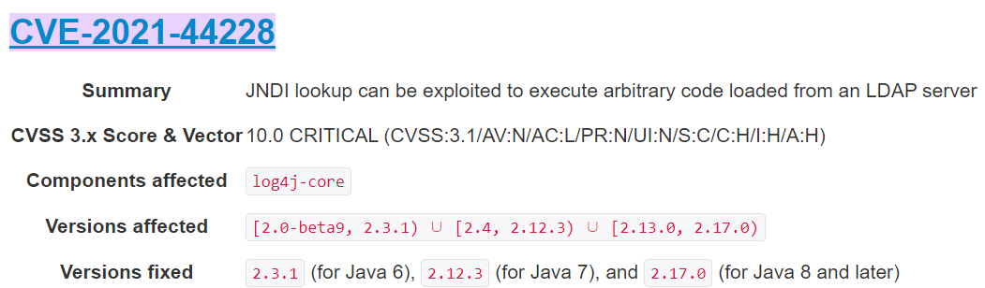
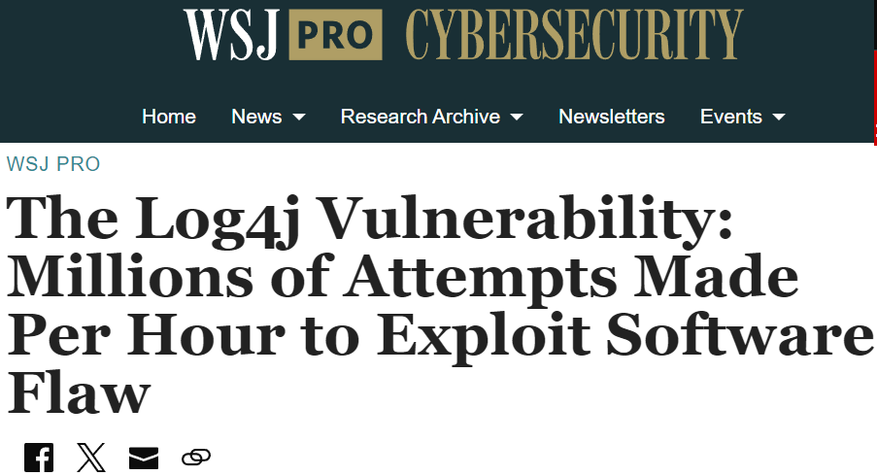
Problem
In 2021, a serious bug was found in Log4J
This Log4j bug was already fixed
Notes:
In two thousand twenty-one, a serious bug was found in Log4J. This bug attracts attention from all over the world. Here are two reports from well-known newspapers. Hackers can use this bug to steal critical information. As Log4j is widely used, millions of systems are affected. After the bug was reported, it was fixed in a few weeks. So, you may believe that the bug is over.

Slide 3
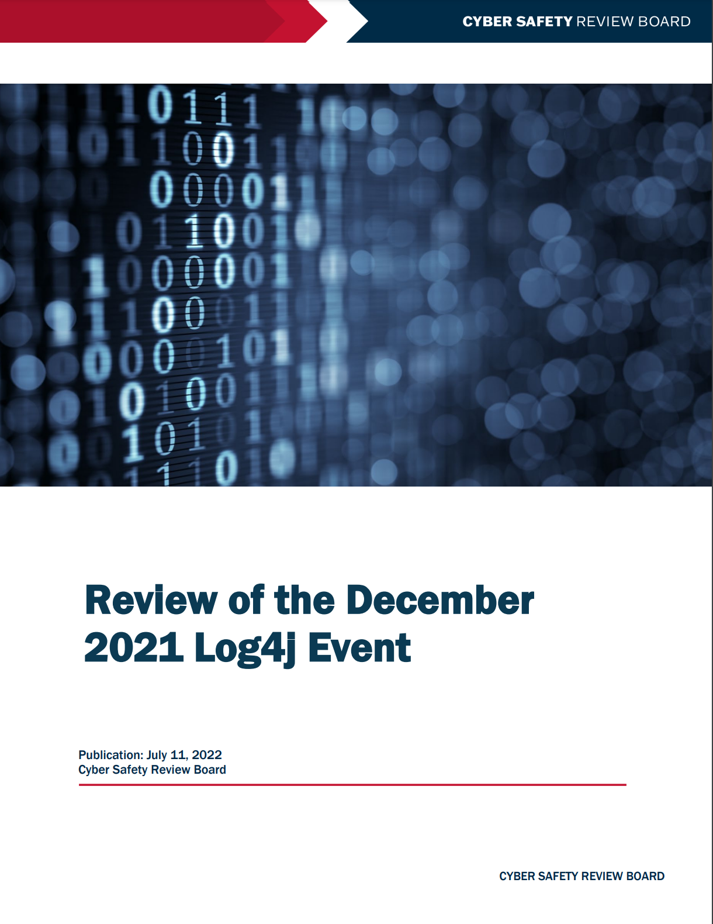

Problem
Most importantly, however, the Log4j event is not over. The Board assesses that Log4j is an “endemic vulnerability” and that vulnerable instances of Log4j will remain in systems for many years to come, perhaps a decade or longer. Significant risk remains.
Notes:
However, many experts disagree. For example, according to a review from America’s cyber defense agency, this bug will remain in systems for many years to come, perhaps a decade or even longer. Why?

Slide 4
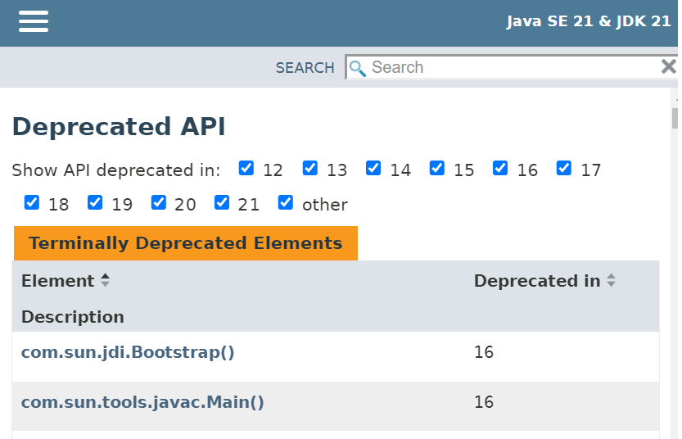
Cause
Lamothe, Maxime, Yann-Gaël Guéhéneuc, and Weiyi Shang. "A systematic review of API evolution literature." ACM Computing Surveys (CSUR) 54.8 (2021): 1-36.
Compilation errors in migrated code
Hidden bugs in migrated code
Another empirical study similarly finds that about half of API changes cause reactions in only 5% of clients and that the overall reaction time is slow [71].
Most API developers appear to introduce breaking changes to simplify the API and introduce new functionality [21]
Notes:
Because a new version library contains many API-breaking changes. For example, API methods can be renamed, and they can return different type of output. If you update your libraries, such changes will introduce many compilation errors and hidden bugs. It takes too much effort to remove compilation errors and hidden bugs. As a result, many programmers are reluctant to update their code, even if it is beneficial to do so. A study shows that only 5% of sampled clients react to API changes. There is a strong need for tool support. Before a tool can remove hidden bugs, this tool must remove all compilation errors. Here, I introduce how researchers reduce compilation errors.

Slide 5
State of the art – Research Line 1
Mining API Mapping
Wei Wu, Yann Gaël Guéhéneuc, Giuliano Antoniol, and Miryung Kim. 2010. Aura: a hybrid approach to identify framework evolution. In Proc. ICSE. 325–334.
Old library
Learning/Mining
API mappings
New library
Old API doc/comment
Old client
Library version 1
New API doc/comment
New client
Library version 2
Chen et al. TSE 2019
Gokhale et al. ICSE 2013
Meng et al. ICSE 2012
Notes:
As the first research line, some tools can mine mappings between old and new APIs. With mined mappings, programmers can replace old API calls with new APIs, and thus reduce compilation errors. Early approaches mine the mappings from library code. Such mappings can also be mined from other sources such as library revision histories, client code, and API docs. Although mappings are quite useful, migrating real projects needs more modifications than replacements.

Slide 6
State of the art – Research line 2
Learning edit script
Na Meng, Miryung Kim, and Kathryn S. McKinley. 2011. Systematic editing: generating program transformations from an example. In Proc. PLDI. 329–342.
Replacing x with y;
Deleting z;…
Old client
Learning/Mining
Edit script
Example
New client
Code to be migrated
applying
Migrated code
Notes:
To resolve this limitation, as the second research line, when there is an example of old and new clients, some other approaches can infer edit scripts. After they are inferred, applying edit scripts can migrate new programs. The scripts are the steps of modifications. Besides replacements, they define other modifications such as deleting and inserting. As a result, scripts can support more complicated modifications.

Slide 7
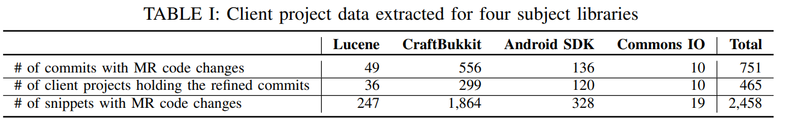
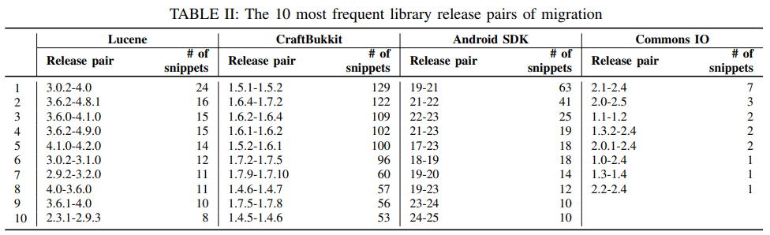
Bottleneck
Migration examples are hard to find
Shengzhe Xu, Ziqi Dong, and Na Meng. 2019. Meditor: inference and application of API migration edits. In Proc. ICPC. 335–346.
Notes:
Although they support more complicated modifications, inferring scripts needs many migration examples. However, it is difficult to collect such examples. For example, in this study, researchers analyze the revision histories from thousands of projects, but they collect only hundreds of migration examples. Migrating real projects needs many more examples. This is a bottleneck for code migration.

Slide 8
Insight
Compiler errors provide valuable hints to migrate code
A project calls the Cassandra library. After we update the library from 1.0.0 to 3.0.0, it produces compilation errors.
Where is the code?
Which API is broken?
authenticated = MessageDigest.isEqual( . . . , FBUtilities.hexToBytes ( props.getProperty ( username ) ) )
How to migrate?
Replacing
authenticated = MessageDigest.isEqual( . . . , ByteBufferUtil.hexToBytes ( props. getProperty( username ));
Handling new compilation errors
authenticated = MessageDigest.isEqual( . . . , ByteBufferUtil.hexToBytes ( props. getProperty( username ) ).array ( ) );
Notes:
In this paper, we propose a new way to bypass the bottleneck. When libraries are updated, API-breaking changes will cause many compilation errors. In this API example, I replace the Cassandra library with a newer version. The replacement causes some compilation errors. Programmers and researchers hate such errors, but we realize that the errors are quite useful for migrating code. Let me use the first compilation error to explain this point. First, this compilation error reports the file name and the line number, from which we can locate the code to be migrated. Second, the compilation error reports the API with breaking changes. As mentioned in this message, the API is hextoBytes. Third, the compilation error provides hints to migrate code. The message says that the API method is undefined. To fix this problem, we can replace this API call with a defined API call. Replacing this API call introduces another compilation error since the new API call produces a different type of output. We must handle the new compilation errors until all of them are resolved.

Slide 9
Approach
Has no errors
Code to be migrated
Compiling
Has errors
Compilation error
Migrated code
New code
Modifying
Migration operators
The overview of LibCatch
Notes:
Based on the above observations, we propose LibCatch. Given a program to be migrated, it compiles the code first. If the code has compilation errors, our tool modifies the code with predefined migration operators. The modifications produce new programs. Our tool then compiles the new programs. The new programs can have different compilation errors. Our tool then modifies them with corresponding migration operators. The process continues until a program has no error. This program is considered as the migrated code. As you can see, migration operators are quite important. How can we construct them?

Slide 10
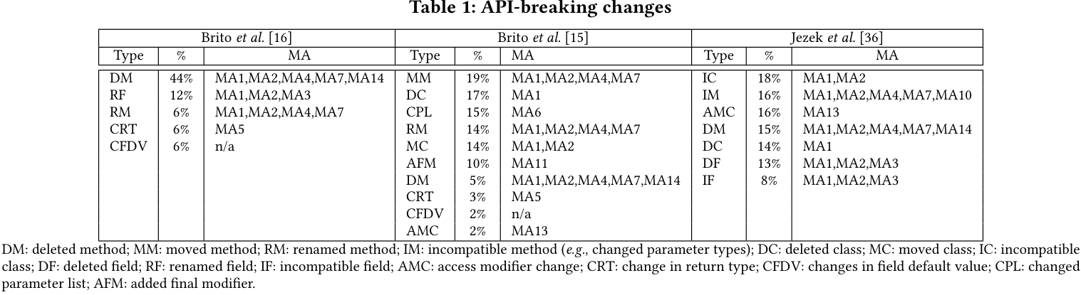
Approach
What are API-breaking changes?
[15] Aline Brito et al. You broke my code: understanding the motivations for breaking changes in APIs. Empirical Software Engineering 25, 2 (2020), 1458–1492.
[16] Aline Brito et al. APIDiff: Detecting API breaking changes. In Proc. SANER 2018. 507–511.
[36] Kamil Jezek, Jens Dietrich, and Premek Brada. 2015. How Java APIs break–an empirical study. Information and Software Technology 65 (2015), 129–146.
Notes:
To construct them, we must know the types of API-breaking changes. Fortunately, researchers have already classified API-breaking changes. Their classification results are different. We considered all their found breaking changes.

Slide 11
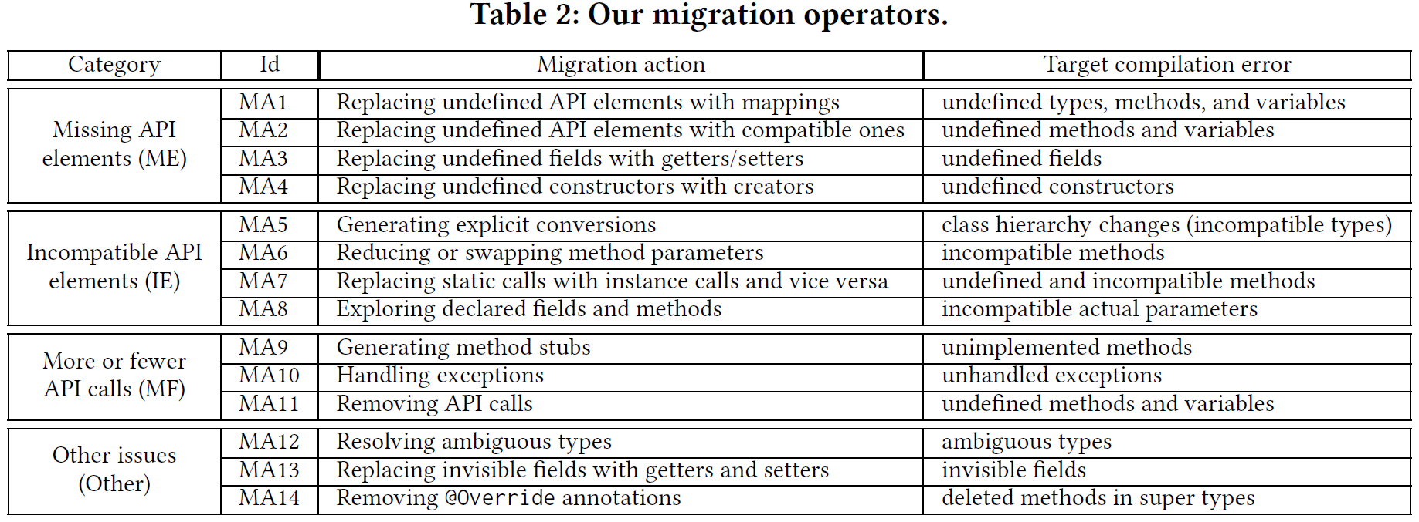
Approach
We define more than one migration operator for a type of compilation error → Opportunities for better selection algorithms
We do not guarantee that our migration operators are the best → Opportunities for better operators
Notes:
For all known API-breaking changes, we define corresponding migration operators. Due to the time limit, I cannot introduce their details. If you are interested, you can read our paper. Here, I want to emphasize two points. First, we define more than one migration operator for each type of compilation error. Sometimes, a compilation error can be resolved by multiple operators. When this happens, our tool randomly selects one of them. Smarter selection algorithms can produce better results. Second, we do not guarantee that our migration operators are the best. There can be better operators.

Slide 12
Evaluation on benchmark
We update the libraries of API usage examples to their next versions. If a replacement produces compilation errors, the produced program is considered a task.
“-” denotes that LibCatch reduces errors, “I” denotes that LibCatch reduces no errors, “+” denotes that LibCatch increase errors, and “full” denotes that LibCatch removes all errors.
Notes:
We have two evaluations. The first evaluation was conducted on a benchmark of five libraries. To prepare the tasks of each library, we modify its API examples to call the next versions. If a replacement causes a compilation error, we consider the modified example as a task. In total, we constructed 123 tasks. The results show that LibCatch reduces the compilation errors of most tasks, and fully removes the compilation errors of half the tasks.

Slide 13
Evaluation on benchmark
We compared our fully migrated API usage examples (61) with the API examples of the next versions
24 examples are identical to manual migrations
In 33 examples, programmers forgot to update API examples in the next versions → Could not be used as labels
In 2 examples, programmers delete them in the next versions → Could not be used as labels
In 2 examples, programmers modify the code of libraries → Labels are not the only wrong answers
All migrated examples have the same semantics with the true labels
Notes:
Programmers should update the examples in the next versions, so we have a gold standard for reference. We then manually compare our fully migrated code with the gold standard. It turns out that the gold standard is not always available. Programmers can forget to update API examples in the next versions but the examples of the next next versions can call APIs that do not appear in the next versions. In addition, programmers can delete examples or modify library code. Still, for valid references, we find that all our migrated examples have the same semantics with the true labels.

Slide 14
Evaluation in the wild
Baseline
SemDiff. Mining API mappings
Meditor. Learning edit scripts
Real projects to be migrated
We select 15 Github projects whose libraries include lucene
We increase the versions of their lucene libraries until API breaking changes cause compilation errors
Measure
We calculate compilation errors after applying the tools
Result
LibCatch removes all compilation errors of 7 projects, and reduces the compilation errors of 6 projects to 1 or 3.
SemDiff can remove 2 compilation errors, but Meditor fails to remove errors.
Notes:
On our benchmark, we did not compare our approach with baselines. The input of our approach cannot be aligned with those of existing research lines. Benchmarks are used to show which technique is the best, but we cannot conduct a controlled experiment. As a result, the comparison does not prove better techniques.
However, in the wild, programmers and researchers want to know the differences. In the second evaluation, we select two typical approaches as our baseline, one from each research line. We select 15 Gitbhub projects. They all take lucene as their library. When we prepare the real projects to be migrated, we increase the versions of lucene until API breaking changes cause compilation errors. As we have no manual references, we calculate the compilation errors after applying these tools.
The results show that LibCatch removes all compilation errors of 7 projects and reduces the compilation errors of 6 projects to 1 or 3. As a comparison, the baseline tools remove only 2 compilation errors.

Slide 15
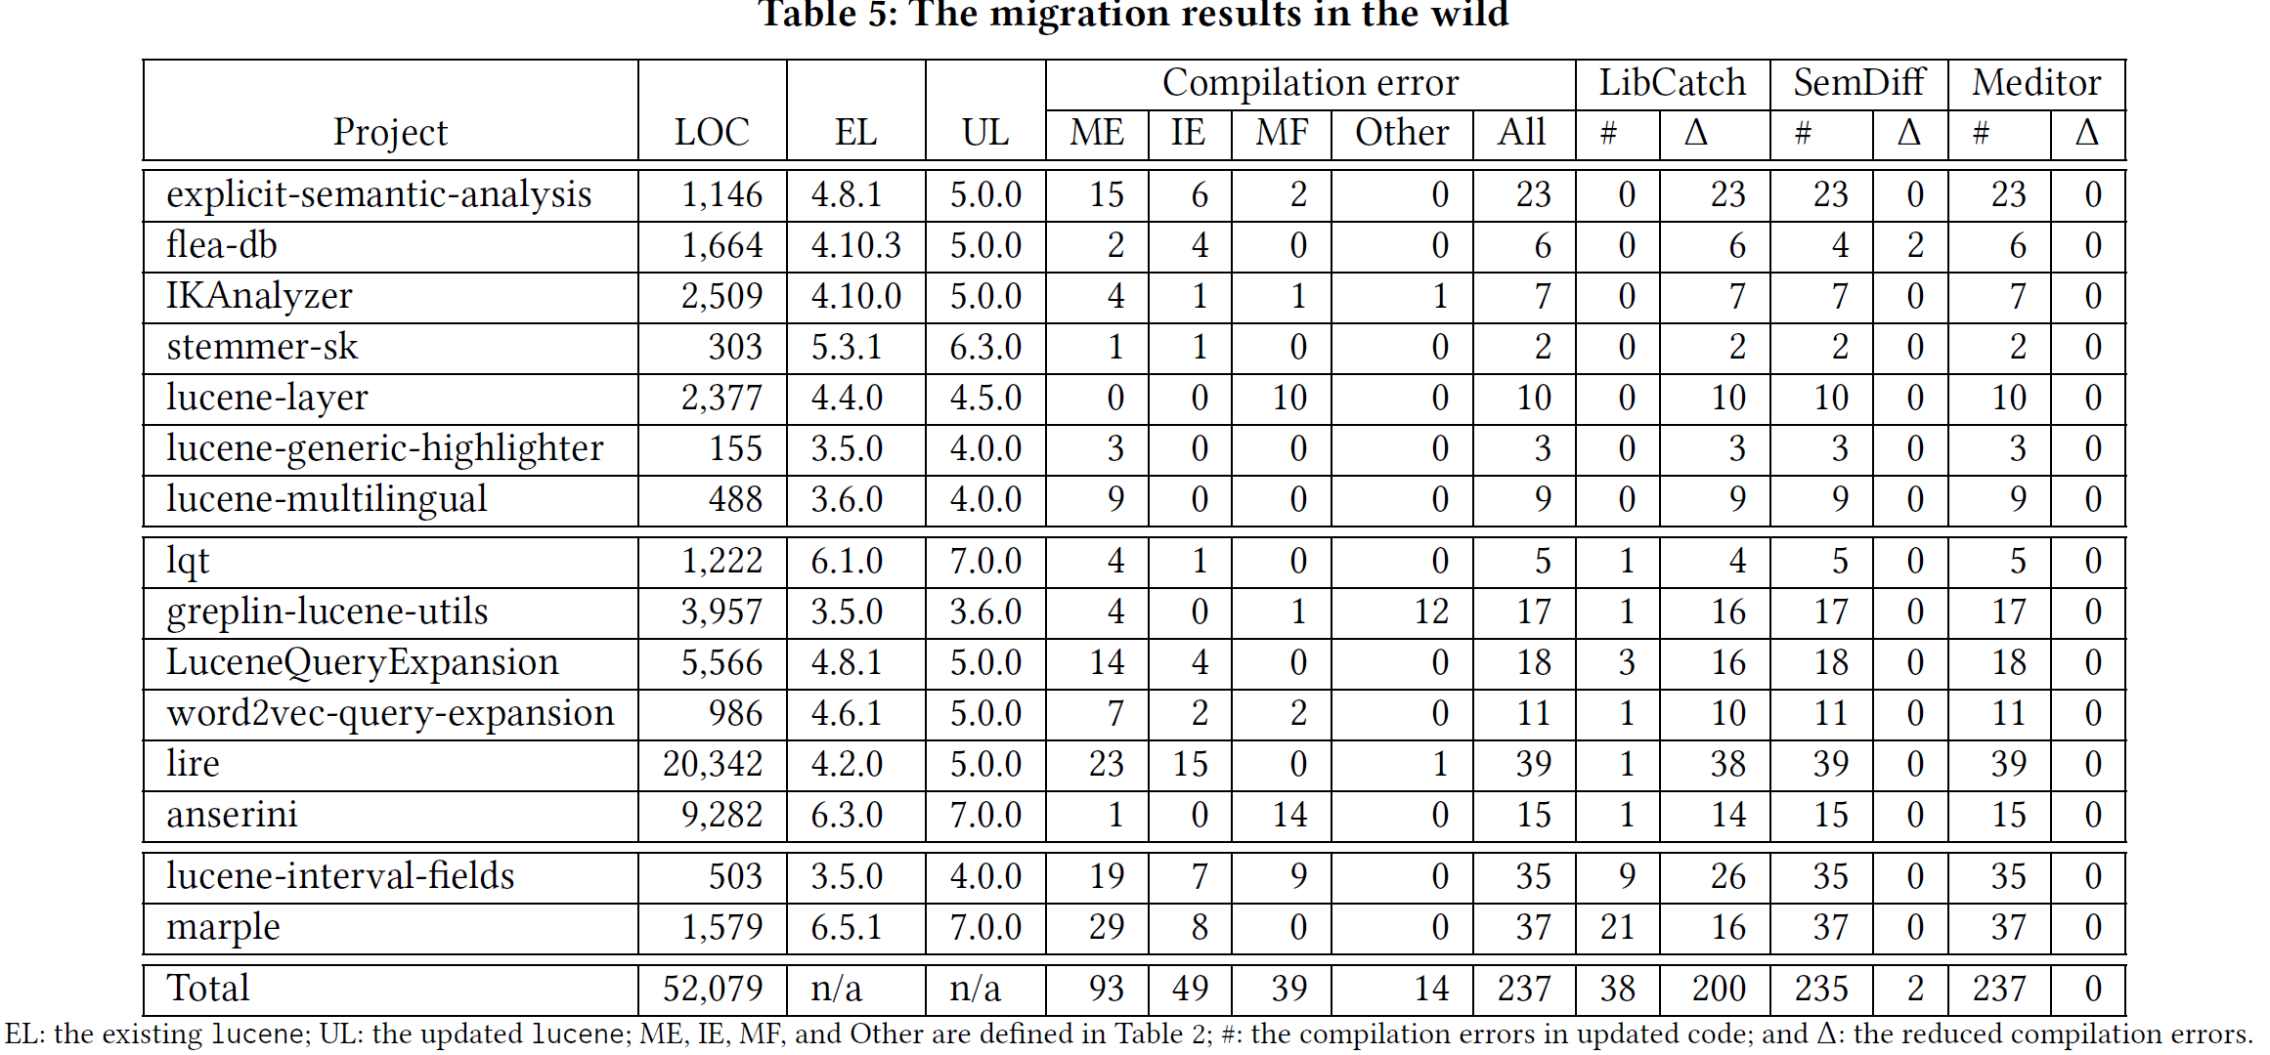
Evaluation in the wild
ME: Missing Element
The upbound of API mappings
Quite difficult to find identical pairs
Notes:
Here are the details. EL lists the old versions and UL lists the new versions. As lucene has a long list of versions, it is difficult to find the matched version pairs from revision histories. As APIs are many, even if such a pair is found, the found project is unlikely to call the same APIs. As a result, edit scripts resolve no compilation error. As for mappings, ME lists all errors caused by missing elements. Mappings can resolve these errors. However, even if an approach can mine all perfect mappings, it still resolves fewer compilation errors than we did. Mappings alone cannot resolve some challenging modifications, but our approach can handle such cases.

Slide 16
Conclusion
We find that compilation errors are quite useful in migrating code
We propose a new way to migrate code, and it uses compilation errors to guide the migration process.
We report the first attempt of migrating real projects, and we remove all compilation errors of 7 projects.
There are many research opportunities
Better migration operators
Better migration algorithms
…
Notes:
In summary, we find that compilation errors are quite useful in migrating code. We thus propose a new way to migrate code. In this way, we use compilation errors to guide the migration process. Our results are promising. However, as the first exploration, there are still many research opportunities. If you are interested, please read our paper and contact us.

Slide 17
Thanks

